Slide 1
Previous Class Recap: RegEx Equivalence with Finite Automata
Regular
Expression
Finite
Automata
Theorem: If 𝑅 is a regular expression and 𝐴 = 𝐿 𝑅
Proof: Convert 𝑅 to equivalent NFA 𝑁:
then 𝐴 is regular
Example:
Convert a ∪ ab ∗ to equivalent NFA
Atomic Elements:
𝑅 = 𝑎 for 𝑎 ∈ Σ
𝑅 = ε
𝑅 = ∅
Composite Elements:
}
Equivalent 𝑁 is:
𝑎
𝑎
𝑏
𝑎
atomic
𝑏
atomic
𝑅 = 𝑅₁ ∪ 𝑅₂
𝑅 = 𝑅₁ ∘ 𝑅₂
Use closure constructions
𝑅 = 𝑅∗
1

Slide 2


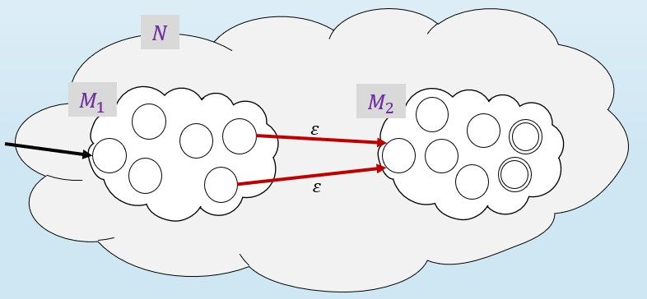
Previous Class Recap: RegEx Equivalence with Finite Automata
Regular
Expression
Finite
Automata
Theorem: If 𝑅 is a regular expression and 𝐴 = 𝐿 𝑅
Proof: Convert 𝑅 to equivalent NFA 𝑁:
then 𝐴 is regular
Example:
Convert
𝑎
a ∪ ab ∗ to equivalent NFA
Atomic Elements:
𝑅 = 𝑎 for 𝑎 ∈ Σ
𝑅 = ε
𝑅 = ∅
Composite Elements:
}
Equivalent 𝑁 is:
𝑎
𝑎
𝑏
atomic
𝑏
atomic
𝑎𝑏
𝑎
ε
𝑏
Concatenation
𝑅 = 𝑅₁ ∪ 𝑅₂
𝑅 = 𝑅₁ ∘ 𝑅₂
Use closure constructions
𝑅 = 𝑅∗
1

Slide 3

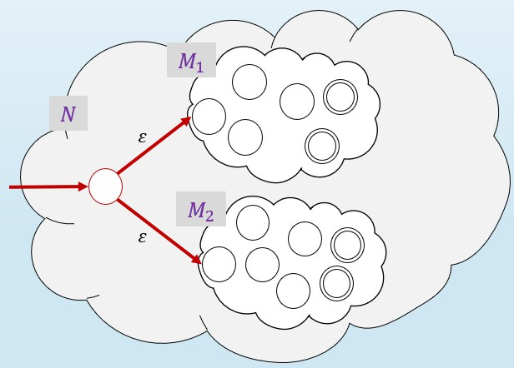
Previous Class Recap: RegEx Equivalence with Finite Automata
Regular
Expression
Finite
Automata
Theorem: If 𝑅 is a regular expression and 𝐴 = 𝐿 𝑅
Proof: Convert 𝑅 to equivalent NFA 𝑁:
then 𝐴 is regular
Example:
Convert
𝑎
a ∪ ab ∗ to equivalent NFA
Atomic Elements:
𝑅 = 𝑎 for 𝑎 ∈ Σ
𝑅 = ε
𝑅 = ∅
Composite Elements:
}
Equivalent 𝑁 is:
𝑎
𝑎
𝑏
𝑏
Union
𝑎
ε
𝑏
𝑎𝑏
𝑎
ε
𝑎 ∪ 𝑎𝑏
𝑎
ε
𝑏
𝑅 = 𝑅₁ ∪ 𝑅₂
𝑅 = 𝑅₁ ∘ 𝑅₂
ε
Use closure constructions
𝑅 = 𝑅∗
1

Slide 4

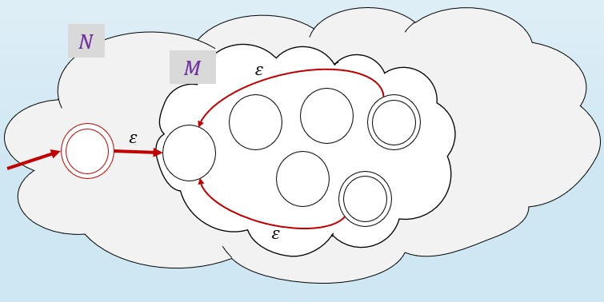
Previous Class Recap: RegEx Equivalence with Finite Automata
Regular
Expression
Finite
Automata
Theorem: If 𝑅 is a regular expression and 𝐴 = 𝐿 𝑅
Proof: Convert 𝑅 to equivalent NFA 𝑁:
then 𝐴 is regular
Example:
Convert
𝑎
a ∪ ab ∗ to equivalent NFA
Atomic Elements:
𝑅 = 𝑎 for 𝑎 ∈ Σ
𝑅 = ε
𝑅 = ∅
Composite Elements:
𝑎
𝑏
𝑎
Star
𝑏
𝑎𝑏
𝑎
ε
𝑏
𝑎
ε
}
𝑎 ∪ 𝑎𝑏
𝑎
ε
𝑏
𝑅 = 𝑅₁ ∪ 𝑅₂
ε
ε
𝑎
𝑅 = 𝑅₁ ∘ 𝑅₂
Use closure constructions
ε
ε
𝑎 ∪ 𝑎𝑏
∗
𝑎
ε
𝑏
𝑅 = 𝑅∗
ε
1
ε

Slide 5
Today’s Goals
Regular Expressions
Finite Automata
Convert Finite Automata to Regular Expression
Before we can do the other side of the proof, we need to:
Look at Regular Expressions in more details
Learn about GNFAs (Generalized NFAs)

Slide 6
Regular Expressions
Like we use arithmetical operations to create arithmetical expressions, we can use regular operations to create regular expressions.
The value of a regular expression is a Language
Atomic Elements Built from 𝛴, ∅, ε
The atomic elements are regular expressions
If 𝛴 = {0,1}
The regular expressions 0, 1, and 𝜀 represent the languages 0 , 1
and {𝜀}. The regular expression ∅ represents the empty language.

Slide 7
Regular Expressions
Like we use arithmetical operations to create arithmetical expressions, we can use regular operations to create regular expressions.
The value of a regular expression is a Language
Atomic Elements Built from 𝛴, ∅, ε
Composite Elements By using ∪, ∘, ∗
The expressions represent the languages obtained by taking the union or concatenation of the languages 𝑅₁ and 𝑅₂, or the star of the language 𝑅₁

Slide 8
Regular Expressions
Like we use arithmetical operations to create arithmetical expressions, we can use regular operations to create regular expressions.
The value of a regular expression is a Language
Atomic Elements Built from 𝛴, ∅, ε
Composite Elements By using ∪, ∘, ∗
Example:
0 ∪ 1 ∗ = 𝛴∗ all the strings over 𝛴
𝛴∗1 = all the strings that end with 1
𝛴∗ ∘ 1
𝛴∗11𝛴∗ = all the strings that contain 11

Slide 9
Regular Expressions – Rules and Notations
Star Binds Tightest
Concatenation Binds Tightest than Union
𝑎𝑏∗ = 𝑎(𝑏∗)
≠ (𝑎𝑏)∗
𝑎𝑏 ∪ 𝑐 = (𝑎𝑏) ∪ 𝑐
≠ 𝑎(𝑏 ∪ 𝑐)
_{𝑹}+
_{𝑹}𝒌
[𝑹]
𝑅⁺ = 𝑅𝑅∗ “one or more”
Ex.: 𝑎𝑎∗
𝑅^{𝑘} = “concatenation of
𝑘 𝑅’s with each other”
Ex.: 𝑏 ³ = 𝑏𝑏𝑏
[𝑅] = (𝑅 ∪ ε)
Ex.: 𝑎 𝑏 = b
ab
“optional”

Slide 10
Regular Expressions – Parsing Practice
How would you parse the following expressions?
𝑅₁ =(𝑎𝑎 𝑏)∪(𝑐 𝑎𝑎 𝑏)∪(𝑐 𝑎𝑎)
𝑅₂ =(𝑑) ∪(𝑎(𝑏∗) 𝑐(𝑑∗))

Slide 11
Regular Expressions – Examples
What is the language of each regular expression?
Assume 𝛴 = {𝑥, 𝑦, 𝑧, 𝑘}
𝑅₁ = 𝑥
𝑅₂ = 𝑥𝑦𝑧𝑘
𝑅₃ = 𝑥𝑦 ∪ 𝑧𝑘
𝑅₄ = 𝑥 𝑦 ∪ 𝑧 𝑘
𝐿 𝑅₁
𝐿 𝑅₂
𝐿 𝑅₃
𝐿 𝑅₄
= {𝑥}
= {𝑥𝑦𝑧𝑘}
= {𝑥𝑦, 𝑧𝑘}
= {𝑥𝑦𝑘, 𝑥𝑧𝑘}
𝑅₅ = 𝑥𝑦∗𝑧
𝐿 𝑅₅ = {𝑥𝑧, 𝑥𝑦𝑧, 𝑥𝑦𝑦𝑧, 𝑥𝑦𝑦𝑦𝑧, … }
𝑅₆ = 𝑥𝑦⁺𝑧
𝐿 𝑅₈ = {}
𝐿 𝑅₆ = {𝑥𝑦𝑧, 𝑥𝑦𝑦𝑧, 𝑥𝑦𝑦𝑦𝑧, … }
𝑅₉ = ∅∗ 𝐿 𝑅₉ = {ε}
𝑅₇ = ∅ 𝐿 𝑅₇ = {}
𝑅₈ = 𝑥(𝑦 ∪ 𝑧)∅
[𝑦]
𝑅₁₀ = 𝑥 𝑦 ∪ ε
𝑘 𝐿 𝑅₁₀
= {𝑥𝑦𝑧, 𝑥𝑧}

Slide 12
Regular Expressions Equivalence with Finite Automata
Regular
Expressions
Finite
Automata
Proof approach: Give a conversion from FA to RegEx
Start with a DFA that recognizes a regular language
Build a GNFA (Generalized NFA)
Reduce the GNFA

Slide 13
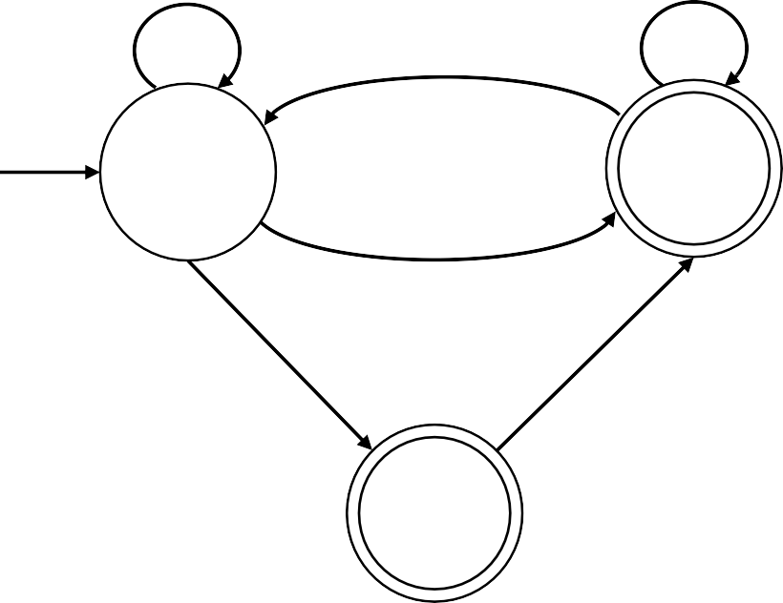
Generalized NFA
Definition: A Generalized Nondeterministic Finite Automaton (GNFA) is similar to an NFA, but allows regular expressions as transition labels
𝑎
_{𝑎}∗_{𝑏}∗
𝑎𝑏
𝑞₁
𝑞₂
𝑏
𝑎 ∪ 𝑏
𝑎𝑎𝑏
𝑞₃

Slide 14
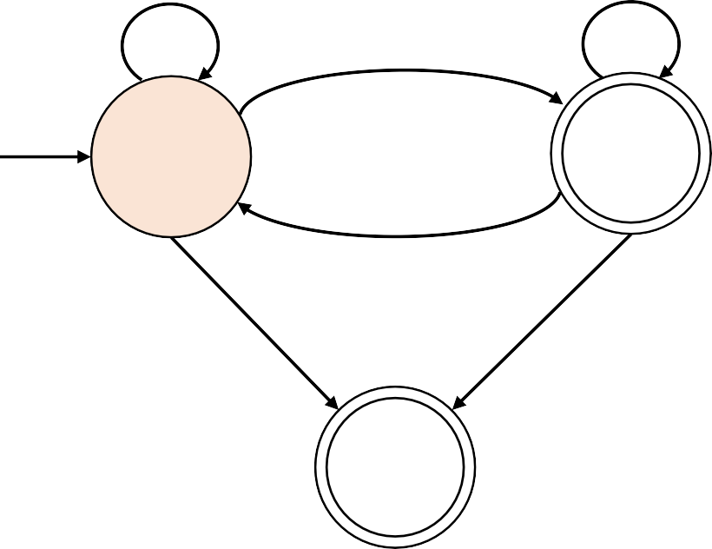
Generalized NFA
Definition: A Generalized Nondeterministic Finite Automaton (GNFA) is similar to an NFA, but allows regular expressions as transition labels
How does GNFAs process the input?
𝑎
_{𝑎}∗_{𝑏}∗
𝑎𝑏
They can read the input in ways that match the transition expression
𝑞₁
𝑞₂
𝑏
Example:
𝑎 ∪ 𝑏
Input: 𝑎𝑎𝑏𝑏𝑎𝑎𝑏
𝑎𝑎𝑏
𝑞₃

Slide 15
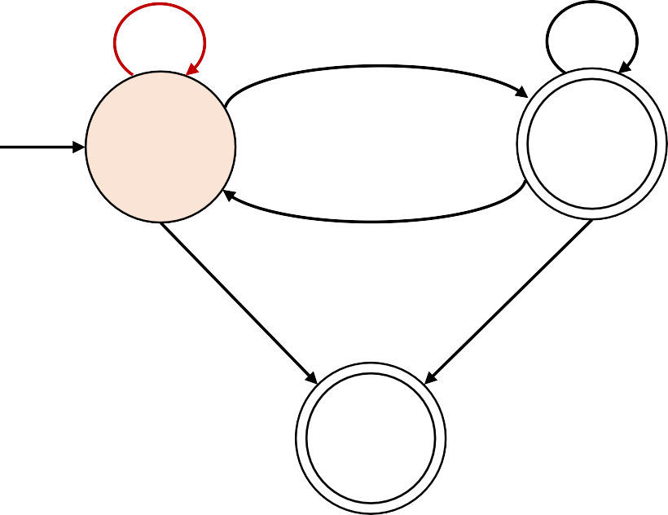
Generalized NFA
Definition: A Generalized Nondeterministic Finite Automaton (GNFA) is similar to an NFA, but allows regular expressions as transition labels
How does GNFAs process the input?
𝑎
_{𝑎}∗_{𝑏}∗
𝑎𝑏
They can read the input in ways that match the transition expression
𝑞₁
𝑞₂
𝑏
Example:
𝑎 ∪ 𝑏
Input: 𝑎𝑎𝑏𝑏𝑎𝑎𝑏
They can read symbols individually
𝑎𝑎𝑏
𝑞₃

Slide 16
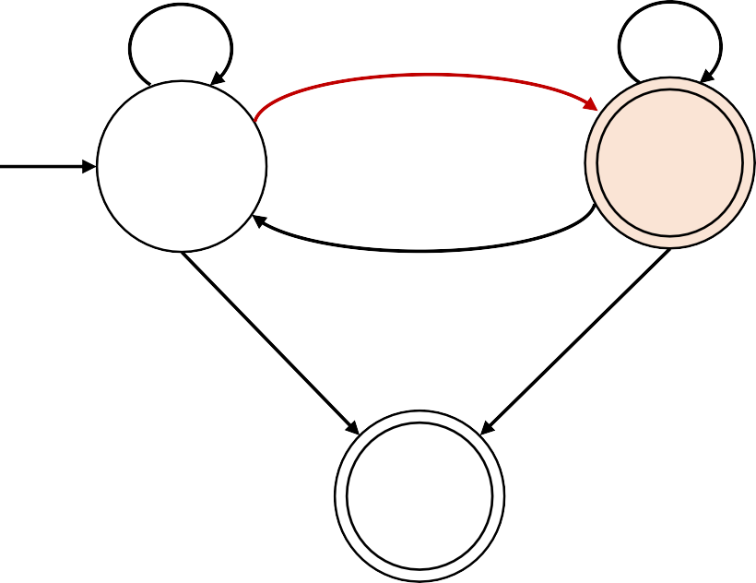
Generalized NFA
Definition: A Generalized Nondeterministic Finite Automaton (GNFA) is similar to an NFA, but allows regular expressions as transition labels
How does GNFAs process the input?
𝑎
_{𝑎}∗_{𝑏}∗
𝑎𝑏
They can read the input in ways that match the transition expression
𝑞₁
𝑞₂
𝑏
Example:
𝑎 ∪ 𝑏
Input: 𝑎𝑎𝑏𝑏𝑎𝑎𝑏
They can read the input in chucks
𝑎𝑎𝑏
𝑞₃

Slide 17
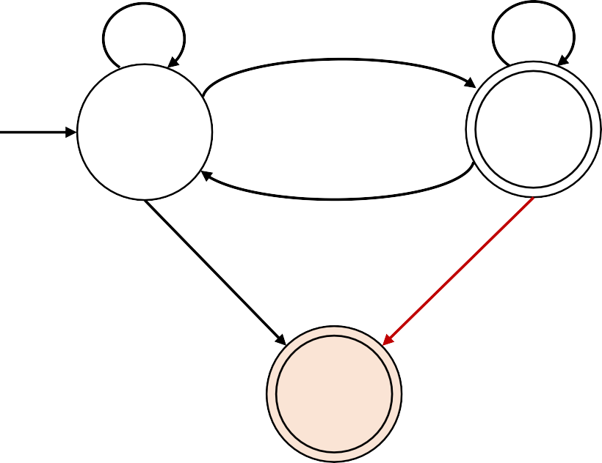
Generalized NFA
Definition: A Generalized Nondeterministic Finite Automaton (GNFA) is similar to an NFA, but allows regular expressions as transition labels
How does GNFAs process the input?
𝑎
_{𝑎}∗_{𝑏}∗
𝑎𝑏
They can read the input in ways that match the transition expression
𝑞₁
𝑞₂
𝑏
Example:
𝑎 ∪ 𝑏
Input: 𝑎𝑎𝑏𝑏𝑎𝑎𝑏
They can read the input in chucks
𝑎𝑎𝑏
𝑞₃
If the GNFA stops in an accept state in the end of the input, the GNFA accepts the input.

Slide 18
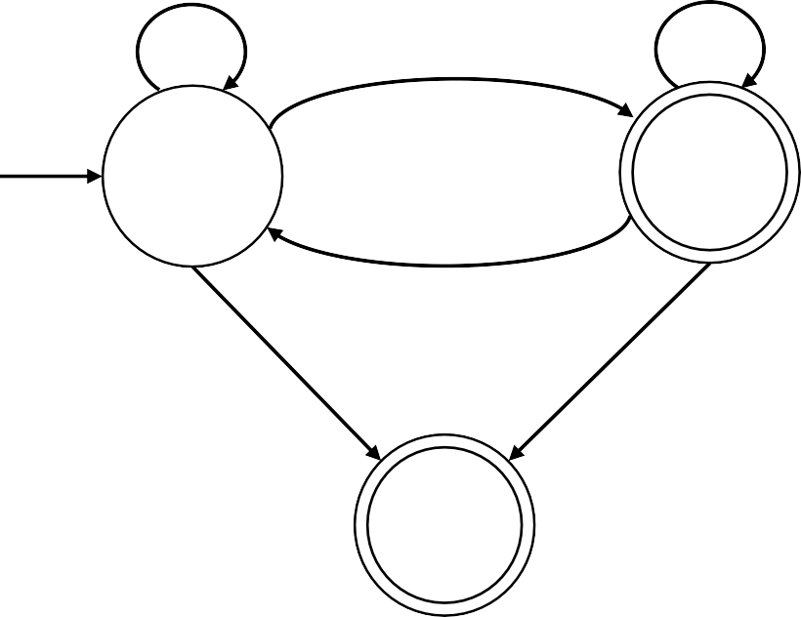
Generalized NFA
Definition: A Generalized Nondeterministic Finite Automaton (GNFA) is similar to an NFA, but allows regular expressions as transition labels
For convenience we will assume:
𝑎
_{𝑎}∗_{𝑏}∗
𝑎𝑏
- One accept state, separate from the start state
𝑞₁
𝑞₂
𝑏
𝑎 ∪ 𝑏
𝑎𝑎𝑏
𝑞₃

Slide 19
Generalized NFA
Definition: A Generalized Nondeterministic Finite Automaton (GNFA) is similar to an NFA, but allows regular expressions as transition labels
For convenience we will assume:
𝑎
_{𝑎}∗_{𝑏}∗
𝑎𝑏
- One accept state, separate from the start state
𝑞₁
𝑞₂
𝑏
ε
𝑎 ∪ 𝑏
𝑎𝑎𝑏
𝑞₃
ε
𝑞₄

Slide 20
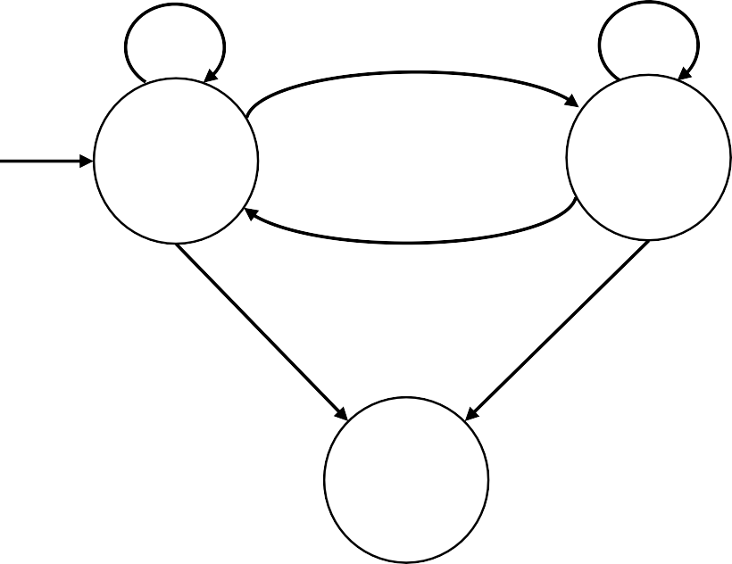
Generalized NFA
Definition: A Generalized Nondeterministic Finite Automaton (GNFA) is similar to an NFA, but allows regular expressions as transition labels
For convenience we will assume:
𝑎
_{𝑎}∗_{𝑏}∗
𝑎𝑏
- One accept state, separate from the start state
𝑞₁
𝑞₂
𝑏
ε
𝑎 ∪ 𝑏
𝑎𝑎𝑏
𝑞₃
ε
𝑞₄

Slide 21
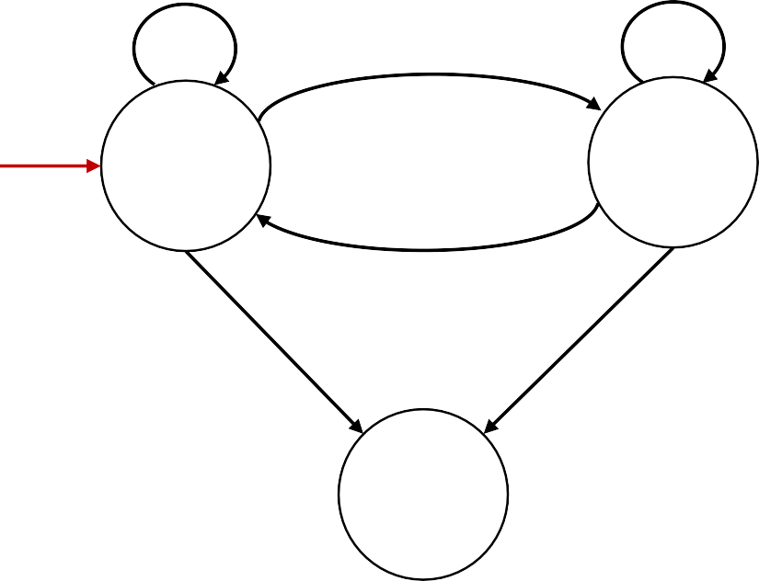
Generalized NFA
Definition: A Generalized Nondeterministic Finite Automaton (GNFA) is similar to an NFA, but allows regular expressions as transition labels
For convenience we will assume:
𝑎
_{𝑎}∗_{𝑏}∗
𝑎𝑏
One accept state, separate from the start state
One arrow from each state to each state, except
ε
𝑞
0
𝑞
1
𝑞
2
𝑏
a) only exiting the start state
ε
𝑎 ∪ 𝑏
𝑎𝑎𝑏
𝑞₃
ε
𝑞₄

Slide 22
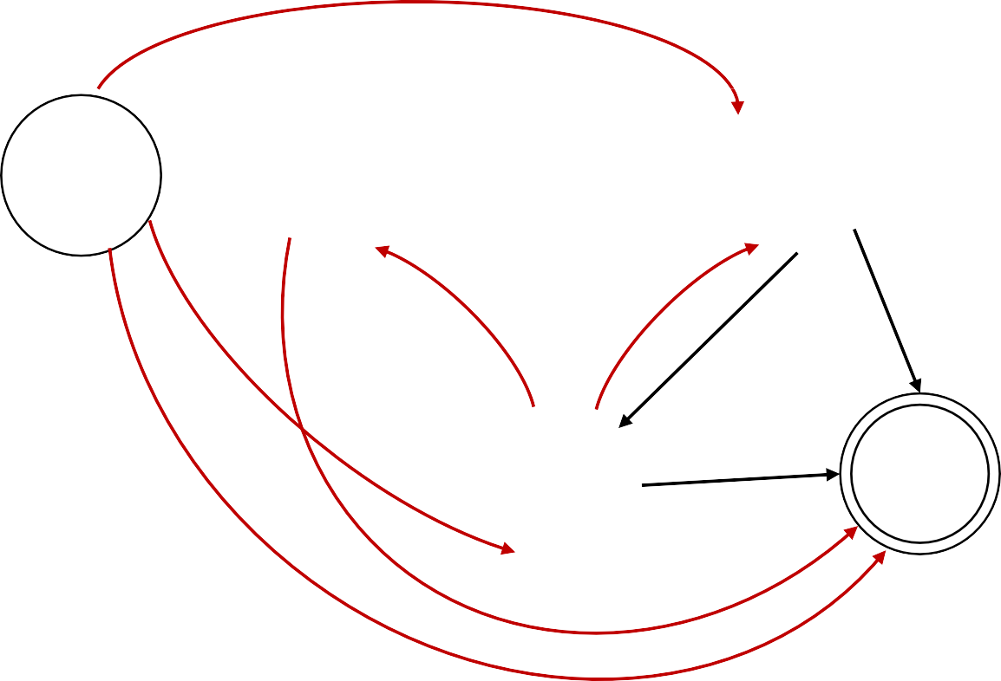
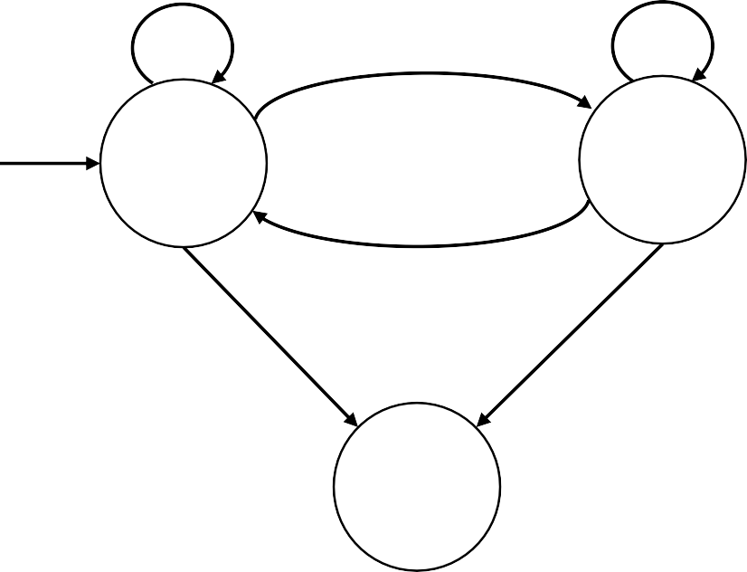
Generalized NFA
Definition: A Generalized Nondeterministic Finite Automaton (GNFA) is similar to an NFA, but allows regular expressions as transition labels
∅
For convenience we will assume:
𝑎
_{𝑎}∗_{𝑏}∗
𝑎𝑏
One accept state, separate from the start state
One arrow from each state to each state, except
ε
𝑞
0
𝑞
1
𝑞
2
𝑏
only exiting the start state
only entering the accept state
∅
∅
∅
ε
𝑎 ∪ 𝑏
∅
𝑎𝑎𝑏
𝑞₃
𝑞₄
ε
∅

Slide 23
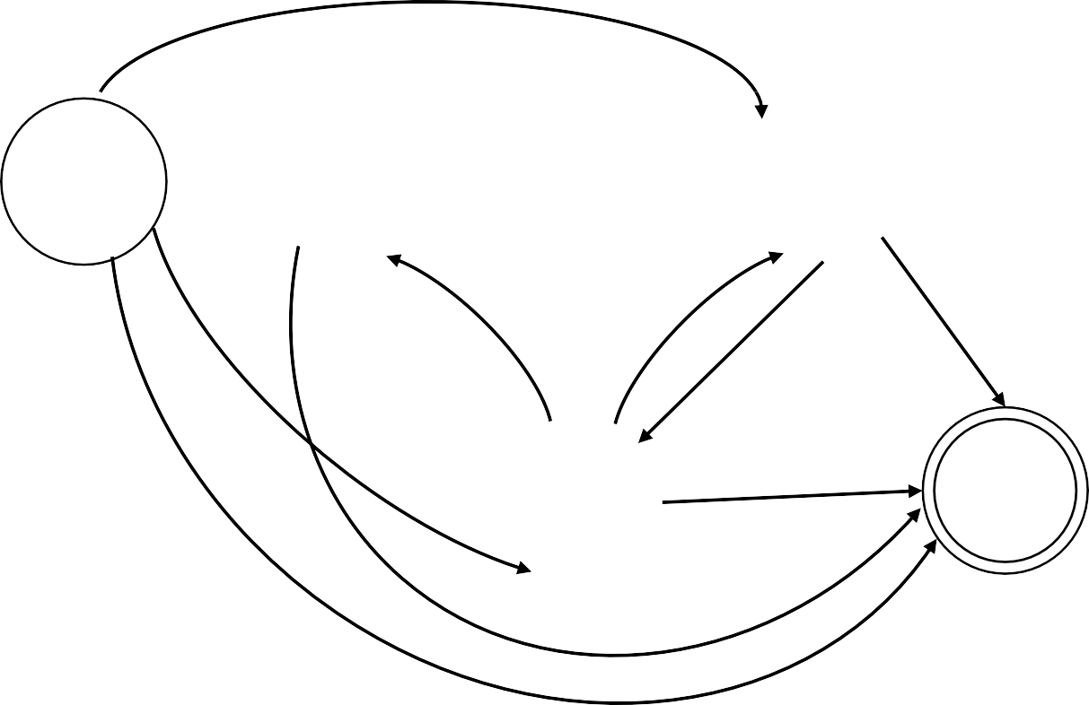

Generalized NFA
Definition: A Generalized Nondeterministic Finite Automaton (GNFA) is similar to an NFA, but allows regular expressions as transition labels
∅
For convenience we will assume:
𝑎
_{𝑎}∗_{𝑏}∗
𝑎𝑏
One accept state, separate from the start state
One arrow from each state to each state, except
ε
𝑞
0
𝑞
1
𝑞
2
𝑏
only exiting the start state
only entering the accept state
∅
∅
∅
ε
𝑎 ∪ 𝑏
∅
𝑎𝑎𝑏
𝑞₃
𝑞₄
ε
∅

Slide 24


GNFA conversion to Regular Expressions
Regular
Expressions
Finite
Automata
Lemma: Every GNFA 𝐺 has an equivalent regular expression 𝑅
Proof: by Induction on the number of states 𝑘 of 𝐺
𝐺 =
𝑅 = 𝑟
Base case: 𝑘 = 2
𝑟
The start and accept state need to be different
Induction step (𝑘 > 2): Assume Lemma true for 𝑘 − 1 states and prove for 𝑘 states
IDEA: Convert 𝑘-state GNFA to equivalent 𝑘 − 1 -state GNFA
Remove one state at the time and using our assumption that we already know how to work with a “smaller” GNFA.
GNFA GNFA
𝑘 states 𝑘 − 1 states

Slide 25
GNFA conversion to Regular Expressions
Regular
Expressions
Finite
Automata
Lemma: Every GNFA 𝐺 has an equivalent regular expression 𝑅
Proof: by Induction on the number of states 𝑘 of 𝐺
Induction step (𝑘 > 2): Assume Lemma true for 𝑘 − 1 states and prove for 𝑘 states
IDEA: Convert 𝑘-state GNFA to equivalent 𝑘 − 1 -state GNFA
𝑘 states 𝑘 − 1 states
- Pick any state except the start and accept states.
𝑥
𝑥
𝑞_{𝑖}
𝑞_{𝑗}
𝑞_{𝑖}
𝑞_{𝑗}

Slide 26
GNFA conversion to Regular Expressions
Regular
Expressions
Finite
Automata
Lemma: Every GNFA 𝐺 has an equivalent regular expression 𝑅
Proof: by Induction on the number of states 𝑘 of 𝐺
Induction step (𝑘 > 2): Assume Lemma true for 𝑘 − 1 states and prove for 𝑘 states
IDEA: Convert 𝑘-state GNFA to equivalent 𝑘 − 1 -state GNFA
𝑘 states 𝑘 − 1 states
- Pick any state except the start and accept states.
𝑥
𝑥
- Remove the state.
𝑞_{𝑖}
𝑞_{𝑗}
𝑞_{𝑖}
𝑞_{𝑗}

Slide 27
GNFA conversion to Regular Expressions
Regular
Expressions
Finite
Automata
Lemma: Every GNFA 𝐺 has an equivalent regular expression 𝑅
Proof: by Induction on the number of states 𝑘 of 𝐺
Induction step (𝑘 > 2): Assume Lemma true for 𝑘 − 1 states and prove for 𝑘 states
IDEA: Convert 𝑘-state GNFA to equivalent 𝑘 − 1 -state GNFA
𝑘 states 𝑘 − 1 states
Pick any state except the start and accept states.
Remove the state.
𝑥
𝑟₂
𝑟₃
𝑥
𝑟₁
- Repair the damage by recovering all paths that went through the state.
𝑞_{𝑖}
𝑞_{𝑗}
𝑞_{𝑖}
𝑞_{𝑗}
𝑟
4
𝑟₁ 𝑟₂ ∗𝑟₃ ∪ 𝑟₄

Slide 28
GNFA conversion to Regular Expressions
Regular
Expressions
Finite
Automata
Lemma: Every GNFA 𝐺 has an equivalent regular expression 𝑅
Proof: by Induction on the number of states 𝑘 of 𝐺
Induction step (𝑘 > 2): Assume Lemma true for 𝑘 − 1 states and prove for 𝑘 states
IDEA: Convert 𝑘-state GNFA to equivalent 𝑘 − 1 -state GNFA
𝑘 states 𝑘 − 1 states
Pick any state except the start and accept states.
Remove the state.
Repair the damage by recovering all paths that went through the state.
𝑥
𝑟₂
𝑟₃
𝑥
𝑟₁
𝑞_{𝑖}
𝑞_{𝑗}
𝑞_{𝑖}
𝑞_{𝑗}
𝑟
4
𝑟₁ 𝑟₂ ∗𝑟₃ ∪ 𝑟₄
- Make the indicated change for each pair of states 𝑞_{𝑖}, 𝑞_{𝑗}.
Thus, DFAs and regular expressions are equivalent.

Slide 29


GNFA conversion to Regular Expressions
Regular
Expressions
Finite
Automata
Lemma: Every GNFA 𝐺 has an equivalent regular expression 𝑅
Proof: by Induction on the number of states 𝑘 of 𝐺
Induction step (𝑘 > 2): Assume Lemma true for 𝑘 − 1 states and prove for 𝑘 states
IDEA: Convert 𝑘-state GNFA to equivalent 𝑘 − 1 -state GNFA
^{𝑘 states 𝑘 − 1 states} - Pick any state except the start and accept
_{𝑥 𝑟2 𝑥} states.
- Remove the state.
^{𝑟1 𝑟3} - Repair the damage by
𝑞_{𝑖 𝑟} 𝑞_{𝑗} 𝑞𝑖 ^{𝑞}𝑗 recovering all paths that
^{4 𝑟}1 ^{𝑟}2 ^{∗𝑟}3 ^{∪ 𝑟}4 went through the state.
- Make the indicated
change for each pair of
Thus, DFAs and regular expressions are equivalent. ^{states 𝑞𝑖, 𝑞𝑗.}
Question:
We just showed how to convert GNFAs to regular expressions, but our
goal was to show that how to convert DFAs to regular expressions. How do we finish our goal?
Show how to convert DFAs to GNFAs
Show how to convert GNFAs to DFAs
We are already done. DFAs are a type of GNFAs.

Slide 30
GNFA conversion to Regular Expressions: Example
Regular
Expressions
Finite
Automata
Simplification of Regular Expressions
𝑅ε = ε𝑅 = 𝑅
Empty string concatenated with a regular expression
𝑅∅ = ∅𝑅 = ∅
Empty symbol concatenated with a regular expression
∅ ∪ 𝑅 = {} ∪ 𝑅 = 𝑅
Empty symbol union with a regular expression

Slide 31
GNFA conversion to Regular Expressions: Example
Regular
Expressions
Finite
Automata
Convert the DFA to equivalent Regular Expression
0,1
0,1
2
𝑞₁
𝑞₂

Slide 32
GNFA conversion to Regular Expressions: Example
Regular
Expressions
Finite
Automata
Convert the DFA to equivalent Regular Expression
1. Convert to GNFA
0,1
0,1
2
𝑞₁
𝑞₂

Slide 33
GNFA conversion to Regular Expressions: Example
Regular
Expressions
Finite
Automata
Convert the DFA to equivalent Regular Expression
1. Convert to GNFA
0 ∪ 1
0 ∪ 1
2
𝑞₁
𝑞₂

Slide 34
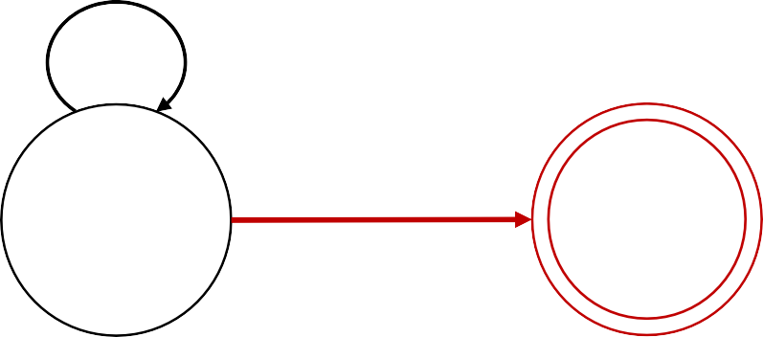
GNFA conversion to Regular Expressions: Example
Regular
Expressions
Finite
Automata
Convert the DFA to equivalent Regular Expression
1. Convert to GNFA
0 ∪ 1
0 ∪ 1
ε
2
ε
𝑠
𝑞₁
𝑞₂
𝑓

Slide 35
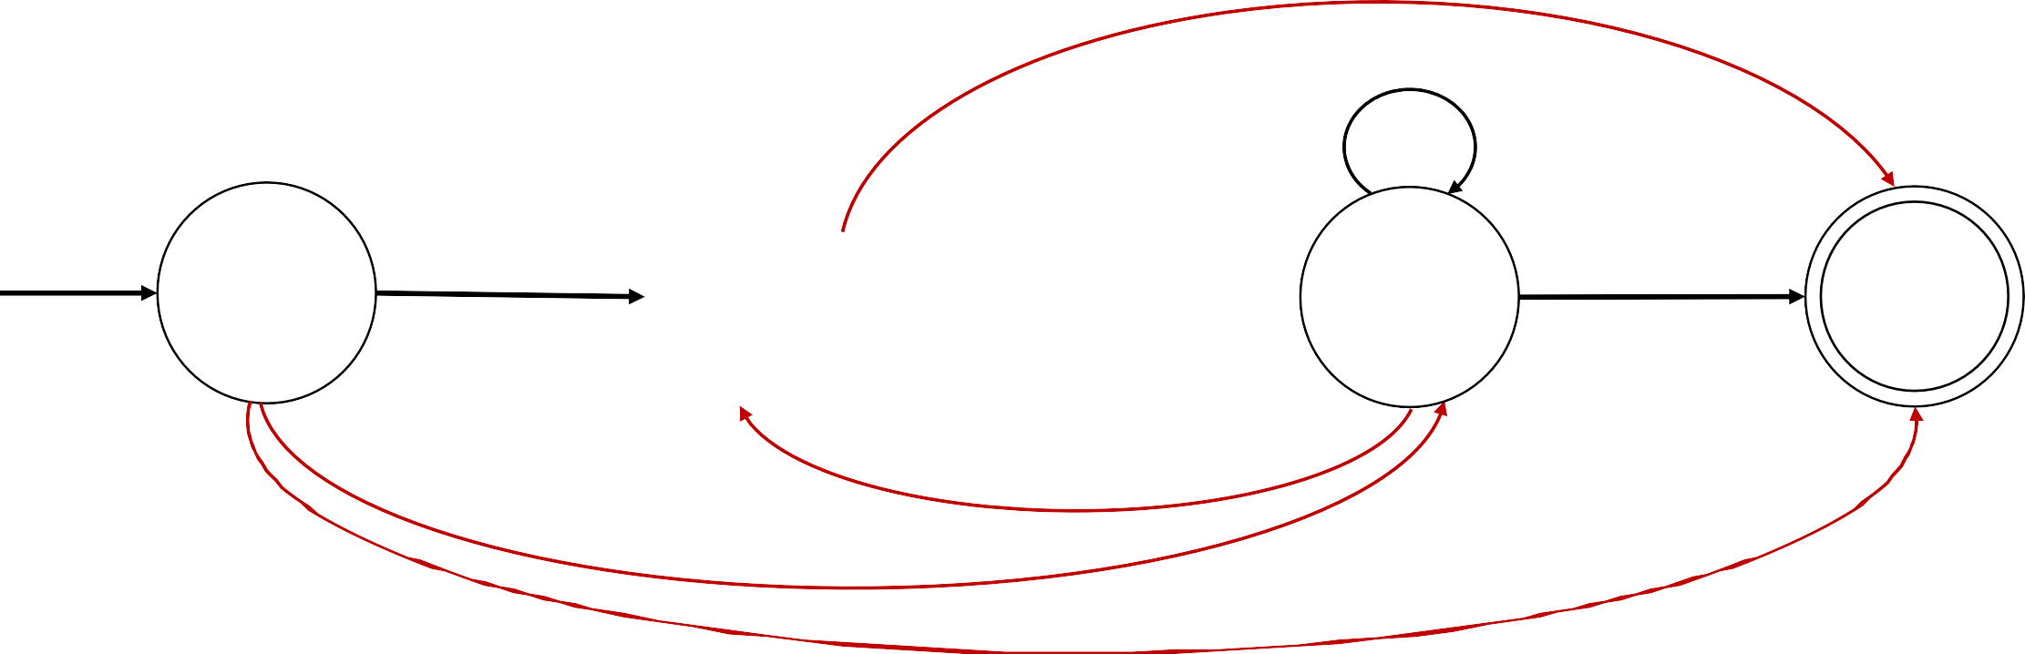
GNFA conversion to Regular Expressions: Example
Regular
Expressions
Finite
Automata
Convert the DFA to equivalent Regular Expression
1. Convert to GNFA
∅
0 ∪ 1
0 ∪ 1
ε
2
ε
𝑠
𝑞₁
𝑞₂
𝑓
∅
∅
∅

Slide 36
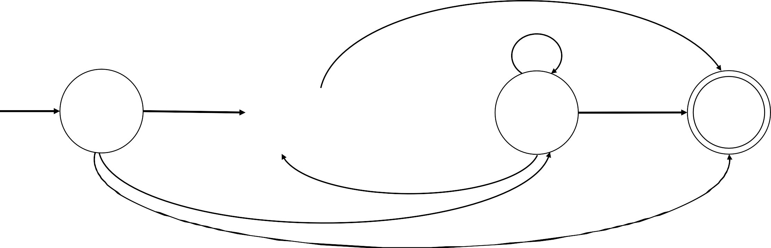
GNFA conversion to Regular Expressions: Example
Regular
Expressions
Finite
Automata
Convert the DFA to equivalent Regular Expression
2. Remove a state and repair the damage by recovering all paths
∅
0 ∪ 1 0 ∪ 1
ε
2
ε
𝑠
𝑞₁
𝑞₂
𝑓
∅
∅
∅

Slide 37
GNFA conversion to Regular Expressions: Example
Regular
Expressions
Finite
Automata
Convert the DFA to equivalent Regular Expression
2. Remove a state and repair the damage by recovering all paths
∅
0 ∪ 1 0 ∪ 1
ε
2
ε
𝑠
𝑞₁
𝑞₂
𝑓
∅
∅
∅

Slide 38
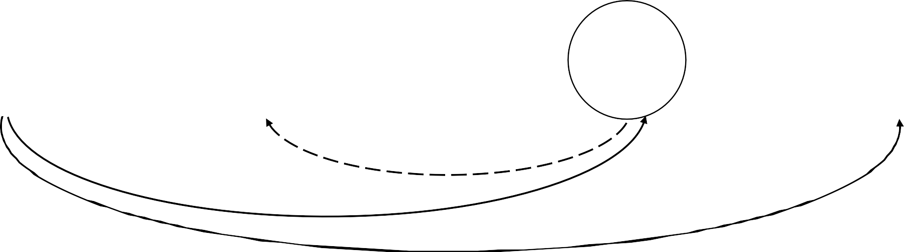
GNFA conversion to Regular Expressions: Example
Regular
Expressions
Finite
Automata
Convert the DFA to equivalent Regular Expression
2. Remove a state and repair the damage by recovering all paths
∅
0 ∪ 1 0 ∪ 1
ε
2
ε
𝑠
𝑞₁
𝑞₂
𝑓
∅
∅
∅

Slide 39
GNFA conversion to Regular Expressions: Example
Regular
Expressions
Finite
Automata
Convert the DFA to equivalent Regular Expression
2. Remove a state and repair the damage by recovering all paths
∅
0 ∪ 1 0 ∪ 1
ε
2
ε
𝑠
𝑞₁
𝑞₂
𝑓
∅
∅ ∪ ε(0 ∪ 1)∗2
∅

Slide 40
GNFA conversion to Regular Expressions: Example
Regular
Expressions
Finite
Automata
Convert the DFA to equivalent Regular Expression
2. Remove a state and repair the damage by recovering all paths
∅
0 ∪ 1 0 ∪ 1
ε
2
ε∪ ∅(0 ∪ 1)∗∅
𝑠
𝑞₁
𝑞₂
𝑓
∅
∅ ∪ ε(0 ∪ 1)∗2
∅

Slide 41
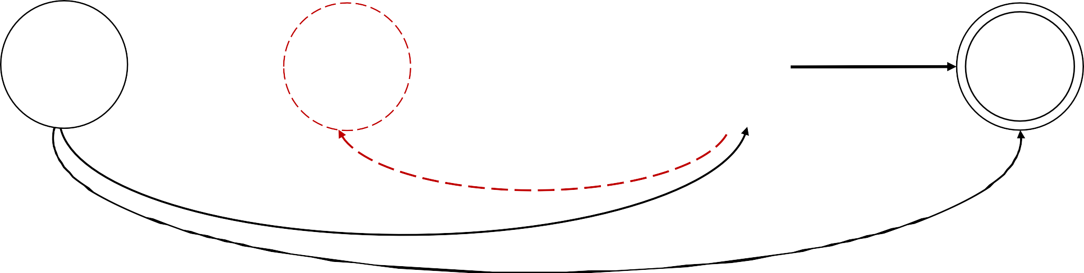
GNFA conversion to Regular Expressions: Example
Regular
Expressions
Finite
Automata
Convert the DFA to equivalent Regular Expression
2. Remove a state and repair the damage by recovering all paths
∅
0 ∪ 1
(0 ∪ 1) ∪ ∅(0 ∪ 1)∗2
ε
2
ε∪ ∅(0 ∪ 1)∗∅
𝑠
𝑞₁
𝑞₂
𝑓
∅
∅ ∪ ε(0 ∪ 1)∗2
∅

Slide 42
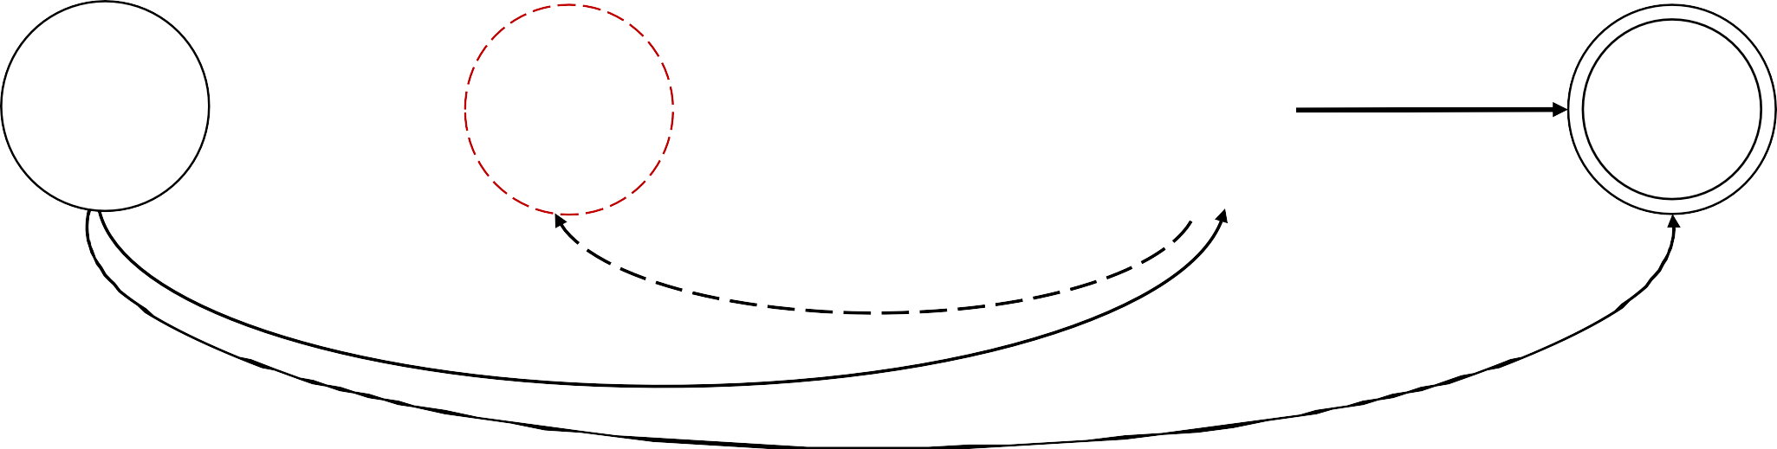
GNFA conversion to Regular Expressions: Example
Regular
Expressions
Finite
Automata
Convert the DFA to equivalent Regular Expression
2. Remove a state and repair the damage by recovering all paths
∅
(0 ∪ 1) ∪ ∅(0 ∪ 1)∗2
0 ∪ 1
ε
2
ε∪ ∅(0 ∪ 1)∗∅
𝑠
𝑞₁
𝑞₂
𝑓
∅
∅ ∪ ε(0 ∪ 1)∗2
∅ ∪ ε(0 ∪ 1)∗∅

Slide 43
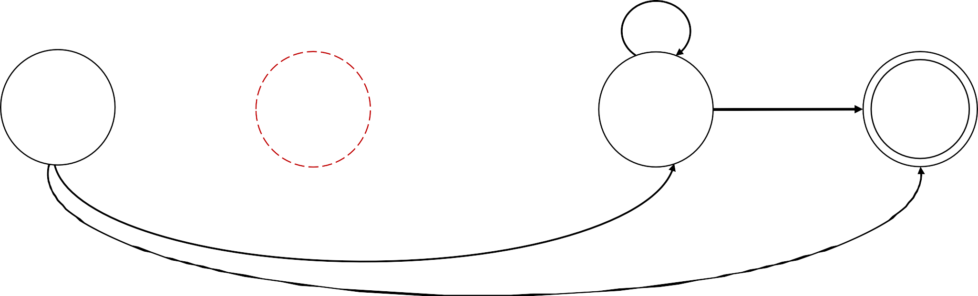
GNFA conversion to Regular Expressions: Example
Regular
Expressions
Finite
Automata
Convert the DFA to equivalent Regular Expression
2. Remove a state and repair the damage by recovering all paths
(0 ∪ 1) ∪ ∅(0 ∪ 1)∗2
ε∪ ∅(0 ∪ 1)∗∅
𝑠
𝑞₁
𝑞₂
𝑓
∅ ∪ ε(0 ∪ 1)∗2
∅ ∪ ε(0 ∪ 1)∗∅

Slide 44
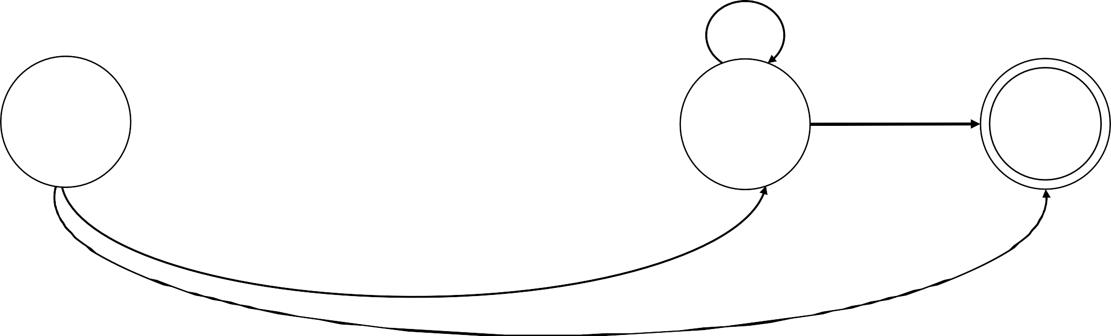
GNFA conversion to Regular Expressions: Example
Regular
Expressions
Finite
Automata
Convert the DFA to equivalent Regular Expression
2. Remove a state and repair the damage by recovering all paths
(0 ∪ 1) ∪ ∅(0 ∪ 1)∗2
ε∪ ∅(0 ∪ 1)∗∅
𝑠
𝑞₂
𝑓
∅ ∪ ε(0 ∪ 1)∗2
∅ ∪ ε(0 ∪ 1)∗∅

Slide 45
GNFA conversion to Regular Expressions: Example
Regular
Expressions
Finite
Automata
Convert the DFA to equivalent Regular Expression
3. Simplify the expressions
(0 ∪ 1) ∪ ∅(0 ∪ 1)∗2
ε∪ ∅(0 ∪ 1)∗∅
𝑠
𝑞₂
𝑓
∅ ∪ ε(0 ∪ 1)∗2
∅ ∪ ε(0 ∪ 1)∗∅

Slide 46
GNFA conversion to Regular Expressions: Example
Regular
Expressions
Finite
Automata
Convert the DFA to equivalent Regular Expression
3. Simplify the expressions
(0 ∪ 1) ∪ ∅(0 ∪ 1)∗2
ε∪ ∅(0 ∪ 1)∗∅
𝑠
𝑞₂
𝑓
(0 ∪ 1)∗2
∅ ∪ ε(0 ∪ 1)∗∅

Slide 47
GNFA conversion to Regular Expressions: Example
Regular
Expressions
Finite
Automata
Convert the DFA to equivalent Regular Expression
3. Simplify the expressions
(0 ∪ 1) ∪ ∅(0 ∪ 1)∗2
ε∪ ∅(0 ∪ 1)∗∅
𝑠
𝑞₂
𝑓
(0 ∪ 1)∗2
∅ ∪ ε(0 ∪ 1)∗∅

Slide 48
GNFA conversion to Regular Expressions: Example
Regular
Expressions
Finite
Automata
Convert the DFA to equivalent Regular Expression
3. Simplify the expressions
(0 ∪ 1) ∪ ∅(0 ∪ 1)∗2
ε∪ ∅(0 ∪ 1)∗∅
𝑠
𝑞₂
𝑓
(0 ∪ 1)∗2
∅

Slide 49
GNFA conversion to Regular Expressions: Example
Regular
Expressions
Finite
Automata
Convert the DFA to equivalent Regular Expression
3. Simplify the expressions
(0 ∪ 1) ∪ ∅(0 ∪ 1)∗2
ε∪ ∅(0 ∪ 1)∗∅
𝑠
𝑞₂
𝑓
(0 ∪ 1)∗2
∅

Slide 50
GNFA conversion to Regular Expressions: Example
Regular
Expressions
Finite
Automata
Convert the DFA to equivalent Regular Expression
3. Simplify the expressions
0 ∪ 1
ε∪ ∅(0 ∪ 1)∗∅
𝑠
𝑞₂
𝑓
(0 ∪ 1)∗2
∅

Slide 51
GNFA conversion to Regular Expressions: Example
Regular
Expressions
Finite
Automata
Convert the DFA to equivalent Regular Expression
3. Simplify the expressions
0 ∪ 1
ε ∪ ∅(0 ∪ 1)∗∅
𝑠
𝑞₂
𝑓
(0 ∪ 1)∗2
∅

Slide 52
GNFA conversion to Regular Expressions: Example
Regular
Expressions
Finite
Automata
Convert the DFA to equivalent Regular Expression
3. Simplify the expressions
0 ∪ 1
ε
𝑠
𝑞₂
𝑓
(0 ∪ 1)∗2
∅

Slide 53
GNFA conversion to Regular Expressions: Example
Regular
Expressions
Finite
Automata
Convert the DFA to equivalent Regular Expression
3. Simplify the expressions
0 ∪ 1
(0 ∪ 1)∗2
ε
𝑠
𝑞₂
𝑓
∅

Slide 54
GNFA conversion to Regular Expressions: Example
Regular
Expressions
Finite
Automata
Convert the DFA to equivalent Regular Expression
2. Remove a state and repair the damage by recovering all paths
0 ∪ 1
(0 ∪ 1)∗2
ε
𝑠
𝑞₂
𝑓
∅

Slide 55
GNFA conversion to Regular Expressions: Example
Regular
Expressions
Finite
Automata
Convert the DFA to equivalent Regular Expression
2. Remove a state and repair the damage by recovering all paths
0 ∪ 1
(0 ∪ 1)∗2
ε
𝑠
𝑞₂
𝑓
∅ ∪ (0 ∪ 1)∗2
0 ∪ 1
∗_{ε}

Slide 56
GNFA conversion to Regular Expressions: Example
Regular
Expressions
Finite
Automata
Convert the DFA to equivalent Regular Expression
2. Remove a state and repair the damage by recovering all paths
𝑠
𝑓
∅ ∪ (0 ∪ 1)∗2
0 ∪ 1
∗_{ε}

Slide 57
GNFA conversion to Regular Expressions: Example
Regular
Expressions
Finite
Automata
Convert the DFA to equivalent Regular Expression
3. Simplify the expressions
(0 ∪ 1)∗2 0 ∪ 1 ∗ε
𝑠
𝑓

Slide 58
Quick review
Regular Languages
Finite Automata
DFAs | NFAs
Regular Expressions
=

Slide 59
Next Class
Nonregular Languages (Textbook Section 1.4)

